Slide 1


Introduction to CSE: Coping with Complexity
SE3331-1 (2024 Fall)
Yubin Xia / Xingda Wei
IPADS, Shanghai Jiao Tong University
https://www.sjtu.edu.cn

Slide 2

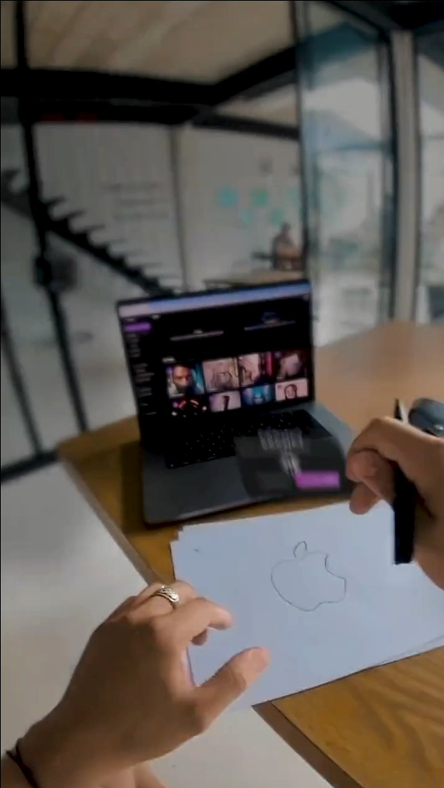
Digital-world VS. Real-world

Slide 3


Digital-world VS. Real-world

Slide 4
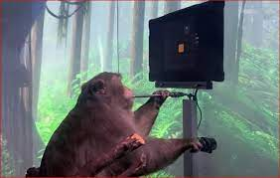
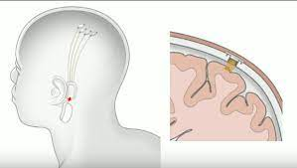
Human Computer Interface…

Slide 5
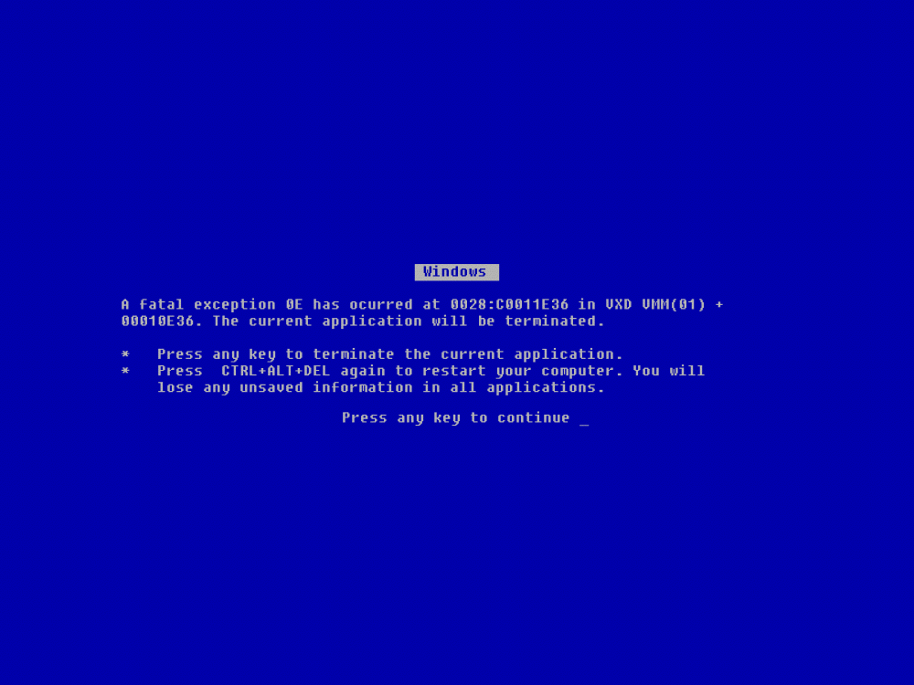

Slide 6
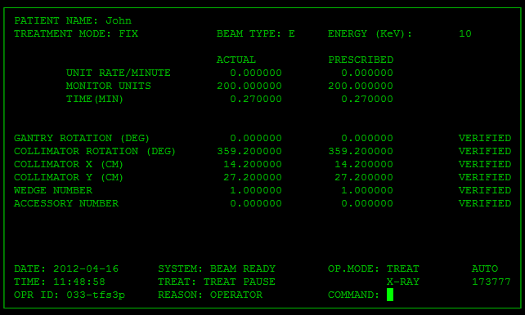
Therac-25 (radiation therapy machine ) accidents (1985-1987), the injured patients died from lethal dosage of radiation caused by a software bug

Slide 7
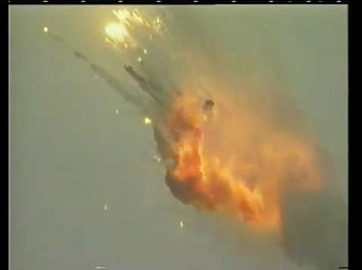
Ariane 5 explosion due to a floating point bug

Slide 8
Jeep自由光系统存在入侵风险，菲亚特克莱斯勒汽车公司召回140万辆汽车

Slide 9


Slide 10
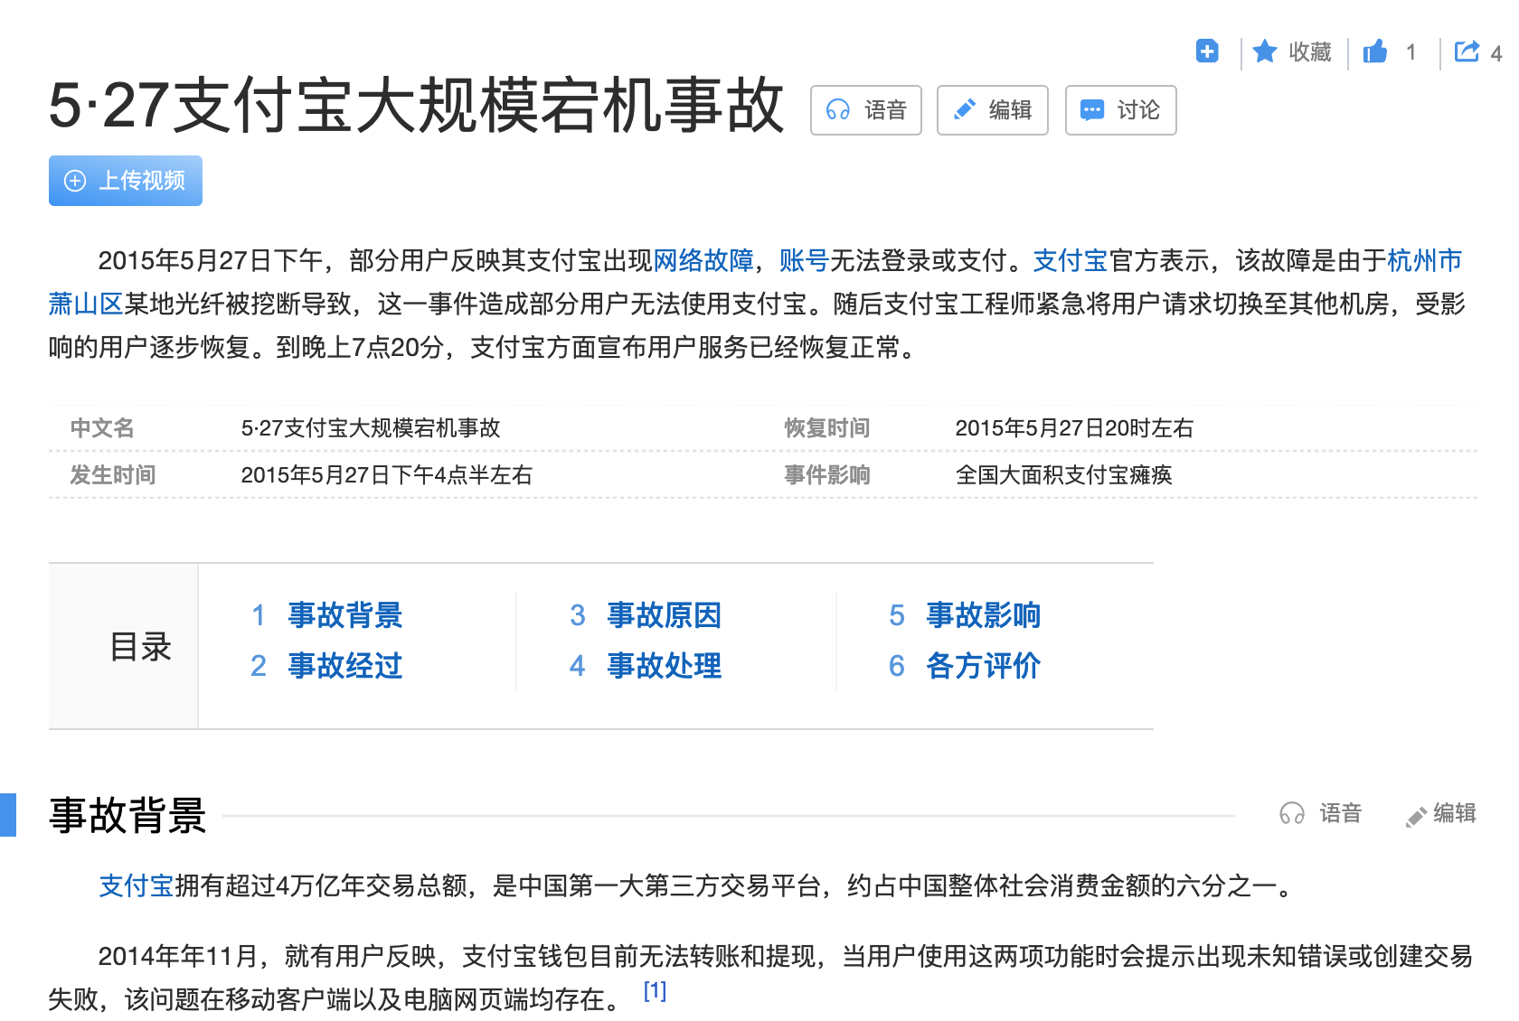

Slide 11


Slide 12
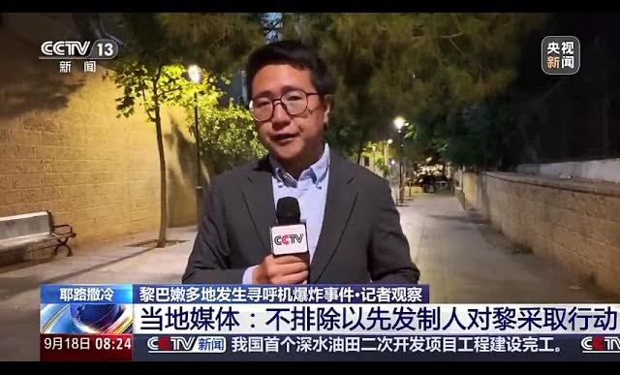
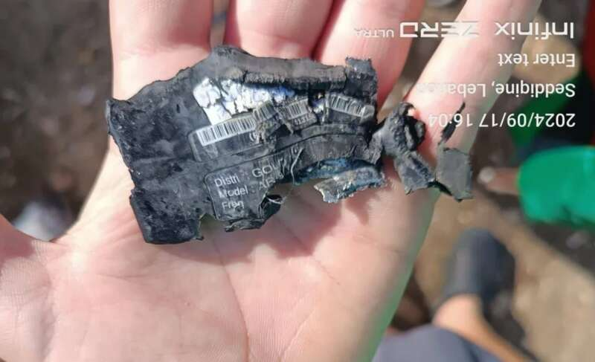
黎巴嫩传呼机爆炸事件

Slide 13
System & Complexity

Slide 14
What is a System?
System =
Interacting set of components with a specified behavior at the interface with its environment
Examples
A web server, an Android phone, file systems, Linux, …

Slide 15
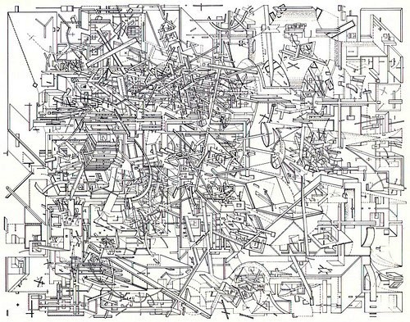
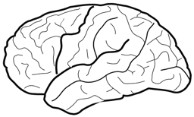
The Problem: Complexity of the Systems
Hard for human to fully understand
But, we can view from a system's perspective

Slide 16
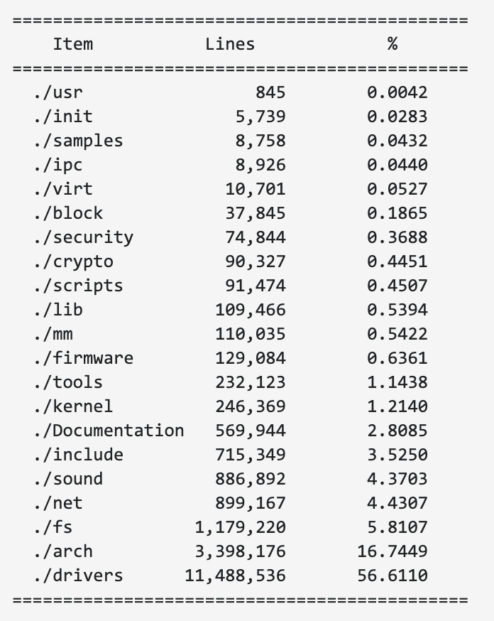
Example of Complex Systems: Linux Kernel
Notes:
More: http://www.informationisbeautiful.net/visualizations/million-lines-of-code/
https://unix.stackexchange.com/questions/223746/why-is-the-linux-kernel-15-million-lines-of-code

Slide 17
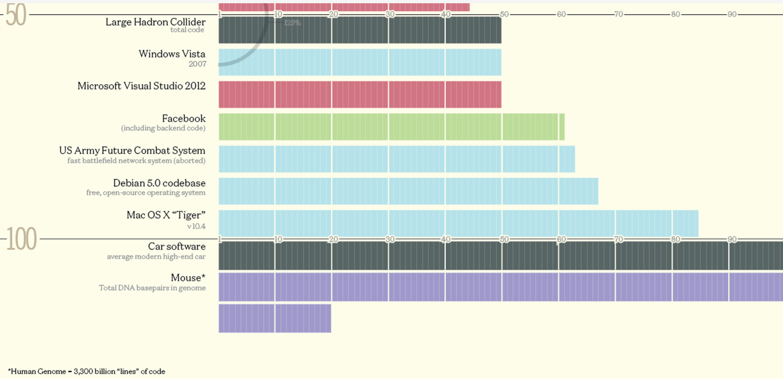
LoCs of Different Systems

Slide 18
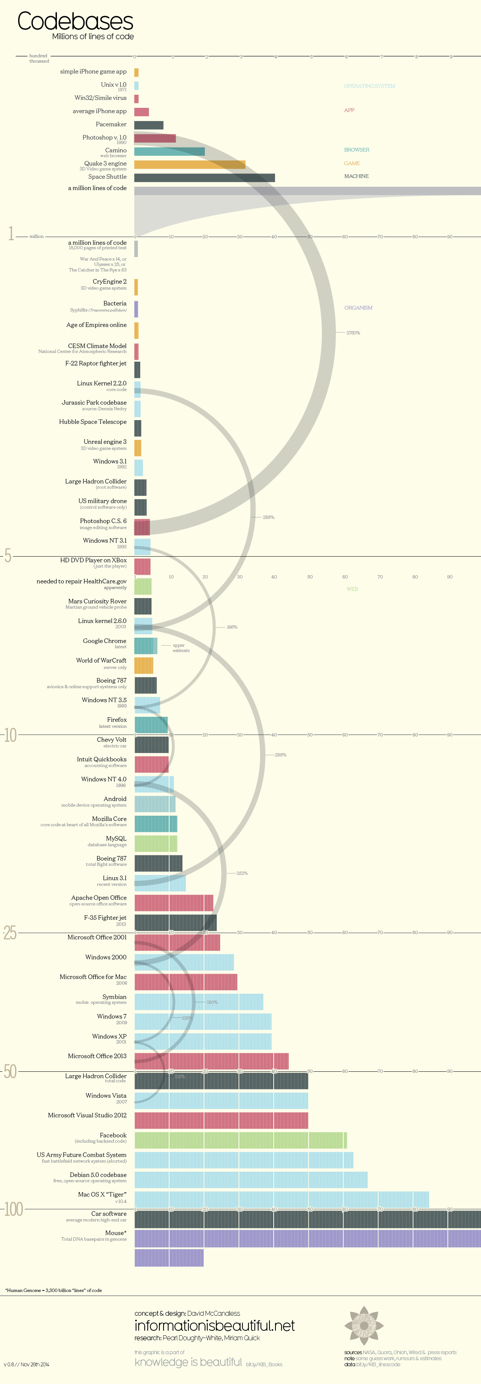
LOC (Lines Of Code)

Slide 19
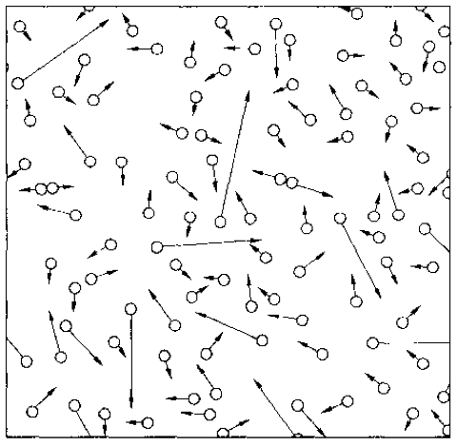
An Example: The Gas System
A systematical way to understand a complex system is needed
Notes:
system has properties that a node has not.
gas molecule properties: speed, a, m, size
gas system properties: pressure, temperature
Computer system properties: consistency, fault tolerance, performance,…

Slide 20
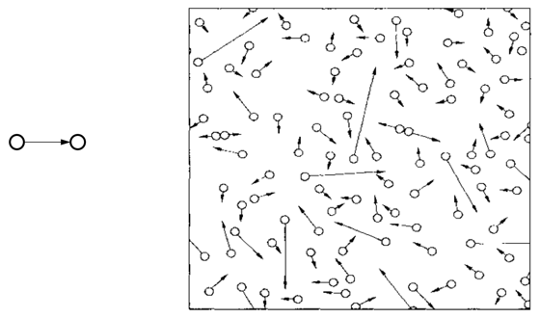
Compare with the Computer Systems
Programming / Data Structure
LoC (Lines of Code): From hundreds to millions
Operating System / Architecture
CPU cores: from one to hundreds
Network
Nodes: from two to millions
Web Service
Clients: from tens to millions
Notes:
Software Engineering:
Programmers: from one to thousands
More on people, not system

Slide 21
14 Properties

Slide 22
14 Properties of Computer Systems
Correctness
Latency
Throughput
Scalability
Utilization
Performance Isolation
Energy Efficiency
Consistency
Fault Tolerance
Security
Privacy
Trust
Compatibility
Usability

Slide 23
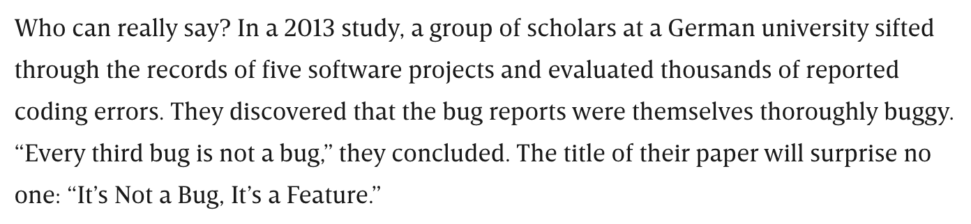
Property-1: Correctness
Correctness is hard to define
How to describe the functionalities of your code?
https://www.wired.com/story/its-not-a-bug-its-a-feature/

Slide 24
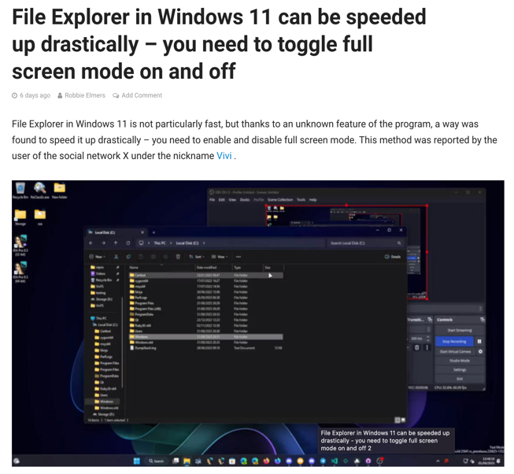


Property-1: Correctness

Slide 25
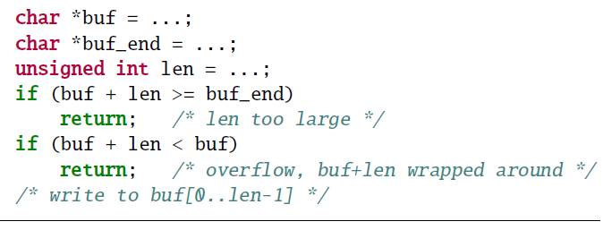
A Piece of Code, Seems Normal

Slide 26
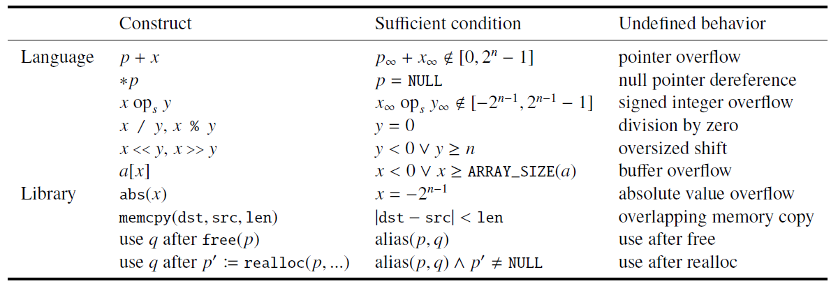
Undefined Behavior

Slide 27
Is This Compilers’ Bug?
A true story: GCC bug #30475 (2007/01/15)
A GCC user:
"This will create MAJOR SECURITY ISSUES in ALL MANNER OF CODE. I don’t care if your language lawyers tell you gcc is right. . . . FIX THIS! NOW!"
A GCC developer:
"I am not joking, the C standard explicitly says signed integer overflow is undefined behavior. . . . GCC is not going to change."
http://gcc.gnu.org/bugzilla/show_bug.cgi?id=30475

Slide 28
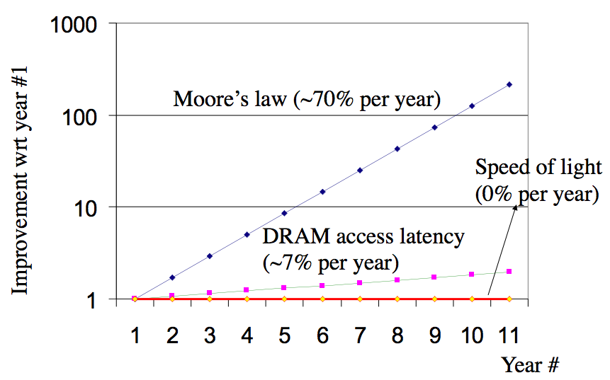
Property-2: Latency
Latency is hard to optimize, it has physical limitations

Slide 29
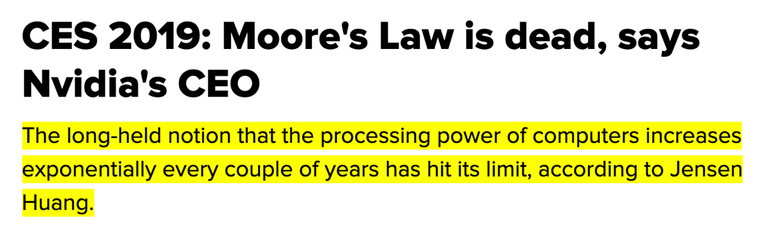
Property-3: Throughput / Capacity
Throughput: a number of transactions / transferred-data per second
7nm → 5nm → 3nm → 2nm... what's next?
Once stop getting smaller, it has to go bigger

Slide 30
Property-4: Scalability
Ideal performance
Real
performance

Slide 31
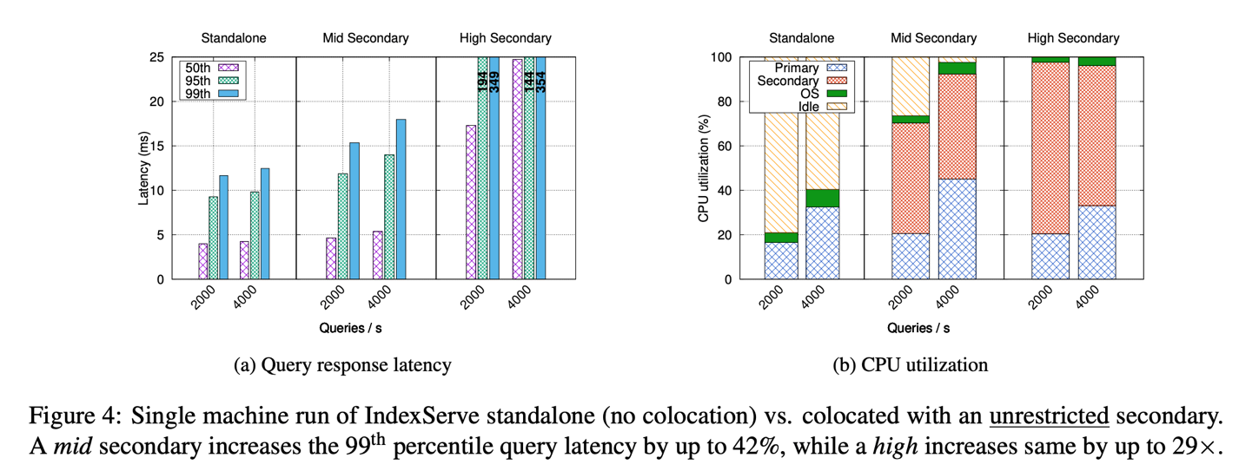
Property-5: Performance Isolation
Iorgulescu, Călin, et al. "Perfiso: Performance isolation for commercial latency-sensitive services." USENIX ATC'18.

Slide 32
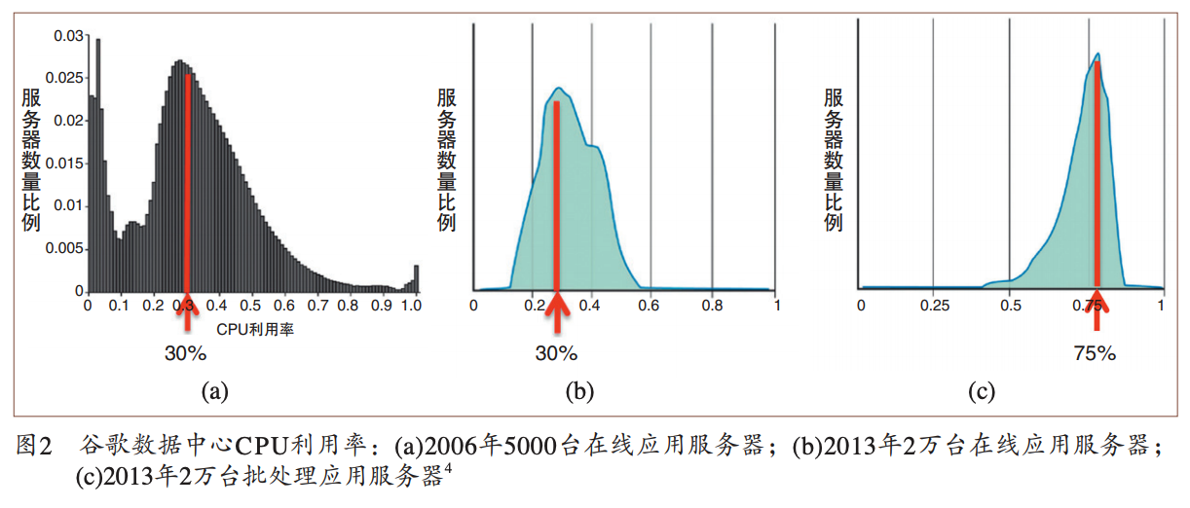
Property-6: Utilization
数据来源：“数据中心成本与利用率现状分析”, 中国计算机学会通讯，2015.

Slide 33

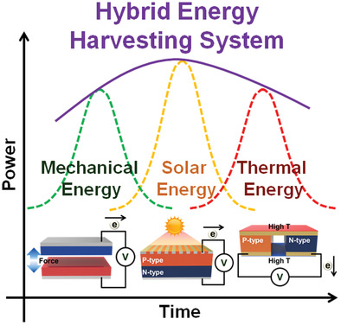

Property-7: Energy Efficiency

Slide 34
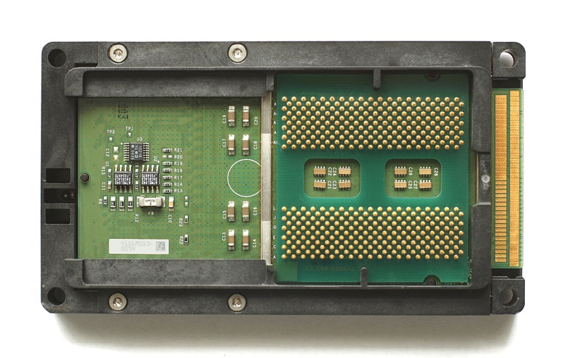
Property-8: Compatibility
Intel's Itanium, 64-bit, not compatible to x86, died.
Itanium Process, from Wikipedia

Slide 35
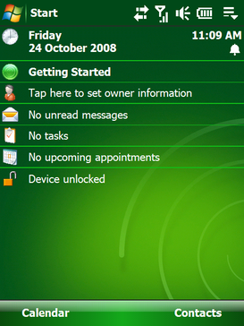
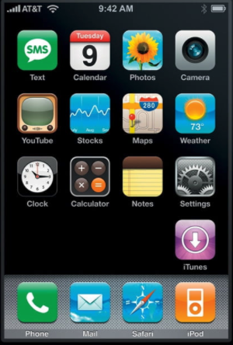
Property-9: Usability

Slide 36
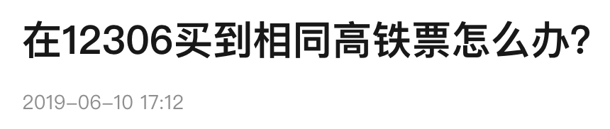
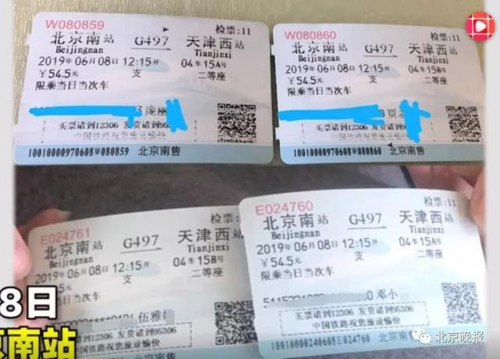
Property-10: Consistency
据时间视频消息，6月8日，北京南站，庞女士和丈夫乘坐G497列车，上车后发现票面上的座位坐了人。庞女士和在座位上的乘客交涉后，发现除了身份证和姓名不一样之外，她们的票和自己手上的票一模一样。两人均是在窗口购票，双方购票相差时间三分钟左右。双方在找到列车长之后，庞女士被安排到了另一个车厢。
针对此事，12306客服回应称这种情况很少见，可能是由于机器故障所致。

Slide 37
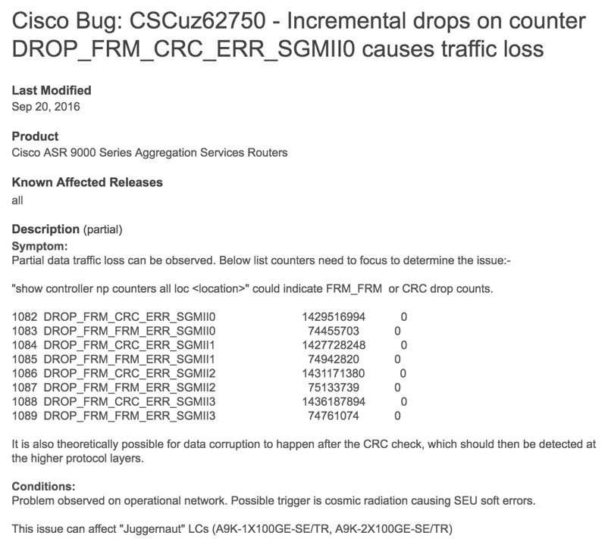
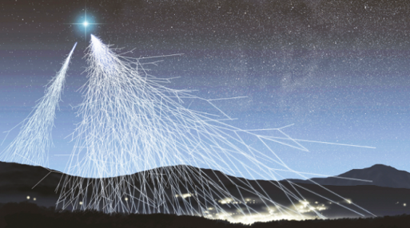
Property-11: Fault Tolerance
A bug of Cisco router is caused by cosmic radiation
Cosmic radiation

Slide 38


Property-11: Fault Tolerance
Row Buffer
Row 1
0
1
1
1
Row 2
Row 3
Row 4
Rowhammer Attack: flip memory bits!

Slide 39
Property-11: Fault Tolerance
Row Buffer
Row 1
0
1
1
1
Row 2
Row 3
Row 4
Rowhammer Attack: flip memory bits!

Slide 40
Property-11: Fault Tolerance
CPU Architecture | Errors | Access-Rate
Intel Haswell (2013) | 22.9K | 12.3M/sec
Intel Ivy Bridge (2012) | 20.7K | 11.7M/sec
Intel Sandy Bridge (2011) | 16.1K | 11.6M/sec
AMD Piledriver (2012) | 59 | 6.1M/sec
Row Buffer
Row 1
0
0
1
1
Row 2
Row 3
Row 4
Rowhammer Attack: flip memory bits!

Slide 41
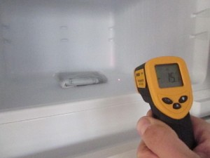
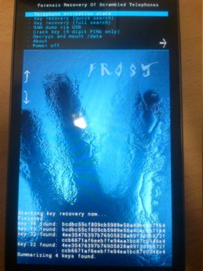
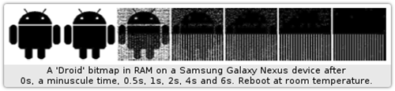
Property-12: Security
Cold-boot attack: physically attack that can scan memory to get any plaintext
Müller, Tilo, and Michael Spreitzenbarth. "Frost." Applied Cryptography and Network Security. Springer Berlin Heidelberg, 2013.

Slide 42
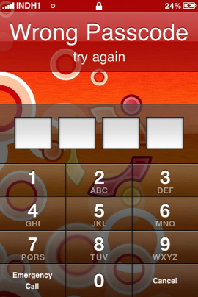
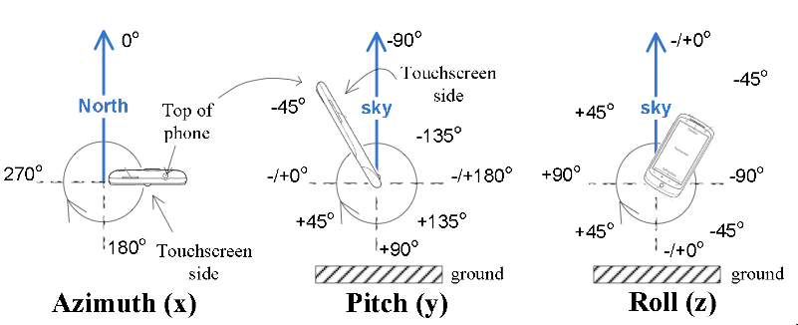
Property-12: Security
Side-Channel: infer PIN code through motion-detector
Cai, Liang, and Hao Chen. "TouchLogger: Inferring Keystrokes on Touch Screen from Smartphone motion." HotSec. 2011.

Slide 43
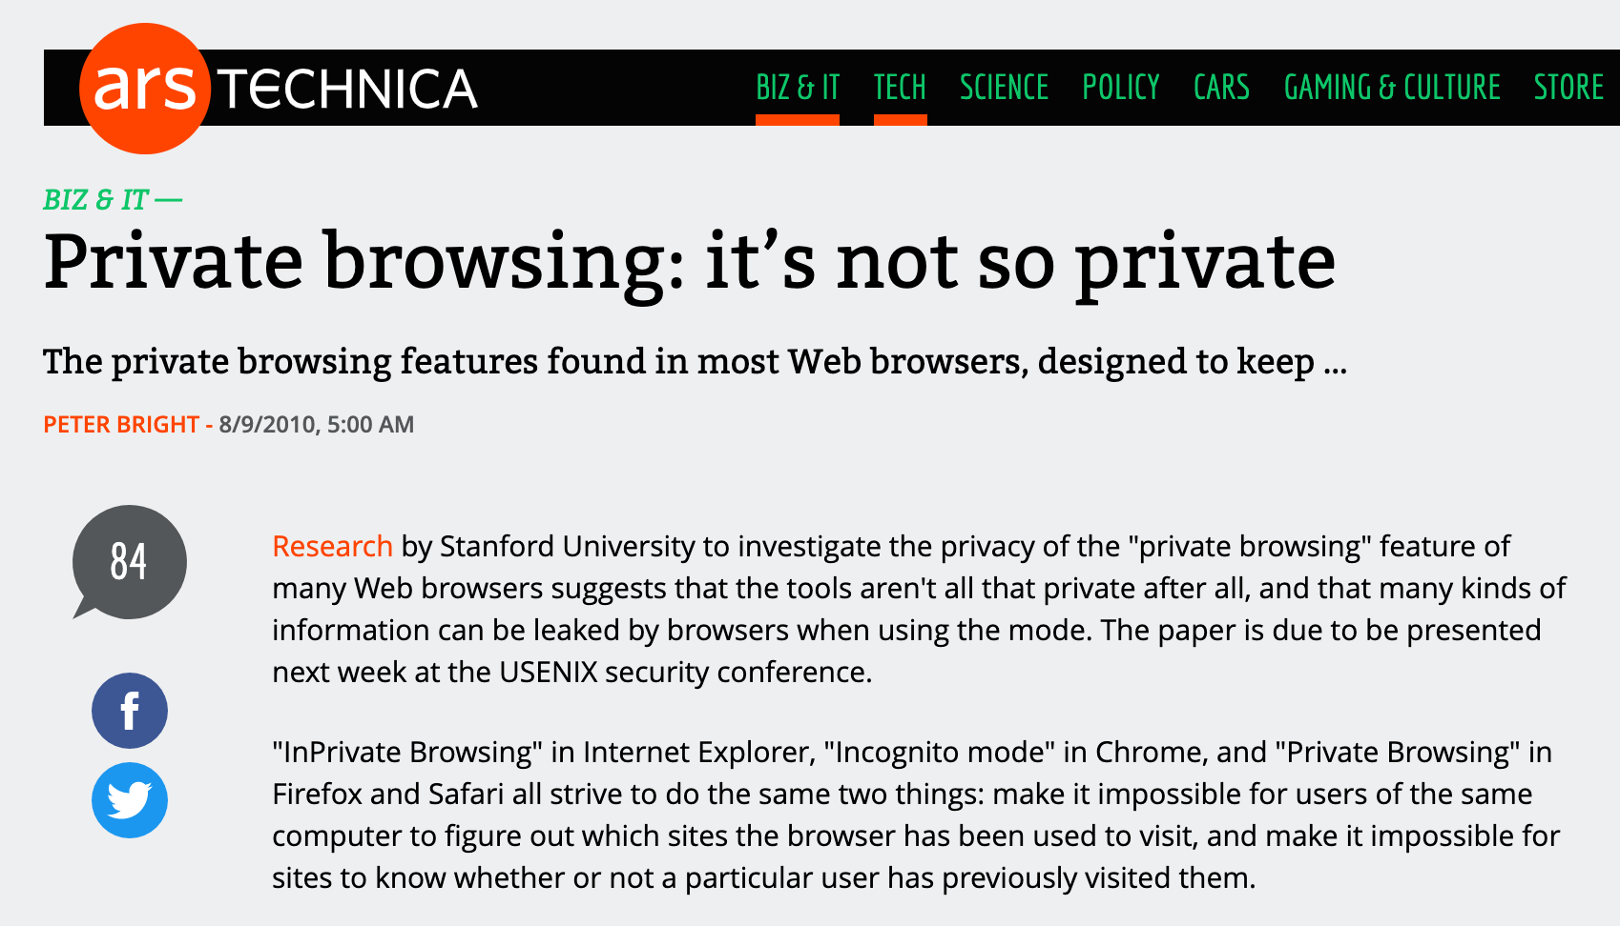
Property-13: Privacy

Slide 44

Property-14: Trust
Guess where is your money?
Fighting Club, 1999

Slide 45
Conflict between these Properties
Usability VS. Privacy
Performance VS. Security
Performance VS. Energy
Fault Tolerance VS. Consistency
...
All these lead to more complexity

Slide 46
System Complexity

Slide 47
Problem Types
Emergent properties (surprise!)
The properties that are not considered at design time
Propagation of effects (butterfly effort)
Small change -> big effect
Incommensurate scaling (growing pains)
Design for small model may not scale
Trade-offs (waterbed effect)
You cannot sell the cow and drink the milk

Slide 48
1. Emergent Properties
Features
No evident in the individual components of a system
But show up when combining those components
Might also be called surprises
An unalterable fact of life: some things turn up only when a system is built

Slide 49
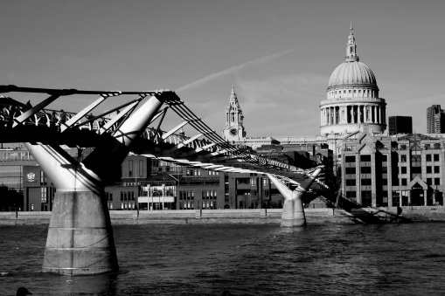
1. Emergent Properties
The Millennium Bridge
For pedestrians over the River Thames in London
Pedestrians synchronize their footsteps when the bridge sways, causing it to sway even more
It had to be closed after only a few days

Slide 50
Emergent Property Example: Ethernet
All computers share single cable
Goal is reliable delivery
Listen while sending to detect collisions
If two nodes sends data at the same time, then both cancel and wait for a random time
00011011
1101100
A
Max length: 1km
B

Slide 51
Does Collision Detection Work?
00011011
1101100
A
Max length: 1km
B
What if A finishes sending before data from B arrives?
1km at 60% speed of light = 5 ms (microseconds)
Original Ethernet Spec: 3 Mbit/sec
A can send 15 bits before bit 1 arrives at B
A must keep sending for 2*5 ms (to detect collision when first bit from B arrives)
Minimum packet size is 5*2*3 = 30 bits
The default header is 5 bytes (40 bits), so no problem for now

Slide 52
3 Mbit/s -> 10 Mbit/s, What will Happen?
First Ethernet standard: 10 Mbit/s, 2.5 km wire
Must send for 2*12.5 µseconds = 250 bits @ 10 Mb/s
Header was 14 bytes
Needed to pad packets to at least 250 bits (~32 bytes)
Emergent property: Minimum packet size!
The 250-bit minimum packet size is a surprise

Slide 53
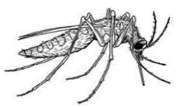
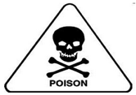
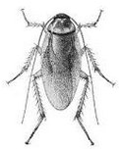
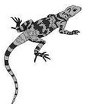


2. Propagation of Effects ^{[Cole'69]}
WHO: tried control malaria in North Borneo
Sprayed villages with DDT
Wiped out mosquitoes, but ….
Roaches collected DDT in tissue
Lizards ate roaches and became slower
Easy target for cats
Cats didn't deal with DDT well and died
Forest rats moved into villages
Rats carried the bacillus for the plague
WHO just replaced malaria with the plague

Slide 54
Example: No Small Changes
Phone network features
CF: Call Forwarding
CNDB: Call Number Delivery Blocking
The caller's number should be hidden
ACB: Automatic Call Back
IB: Itemized Billing
CF
CF
A
C
??
CNDB
ACB + IB
A calls B, B is busy
Once B is done, B automatically calls A
A's (caller) number appears on B's bill
A
B

Slide 55
3. Incommensurate Scaling
As a system increases in size or speed, not all parts of it follow the same scaling rules
So things stop working
The mathematical description
Different parts of the system exhibit different orders of growth

Slide 56
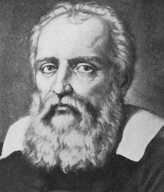
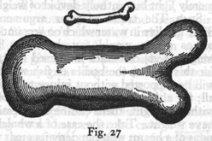
3. Incommensurate Scaling
Galileo in 1638
To illustrate briefly, I have sketched a bone whose natural length has been increased three times and whose thickness has been multiplied until, for a correspondingly large animal, it would perform the same function which the small bone performs for its small animal.
From the figures here shown you can see how out of pro- portion the enlarged bone appears.
Galileo

Slide 57
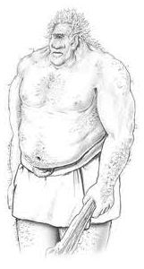
3. Incommensurate Scaling
Galileo in 1638
Clearly then if one wishes to maintain in a great giant the same proportion of limb as that found in an ordinary man he must either find a harder and stronger material for making the bones, or he must admit a diminution of strength in comparison with men of medium stature; for if his height be increased inordinately he will fall and be crushed under his own weight.

Slide 58
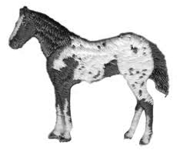
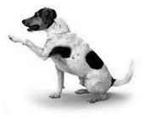
3. Incommensurate Scaling
Galileo in 1638
Whereas, if the size of a body be diminished, the strength of that body is not diminished in the same proportion; indeed the smaller the body the greater its relative strength. Thus a small dog could probably carry on his back two or three dogs of his own size; but I believe that a horse could not carry even one of his own size.

Slide 59
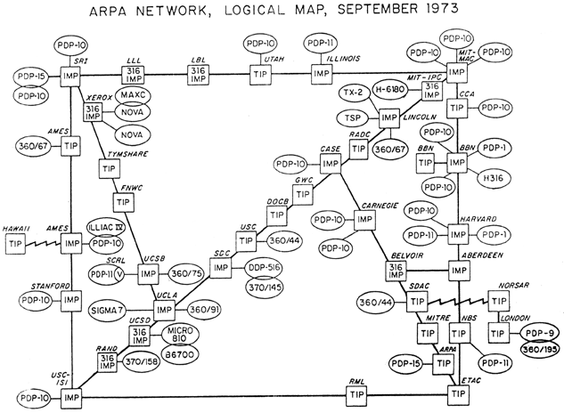
3. Incommensurate Scaling

Slide 60
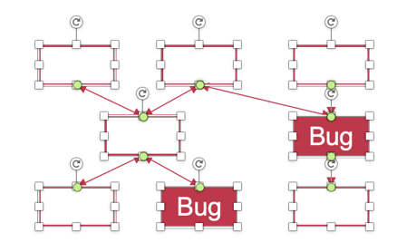
Example: Scaling Figures in PPT
Bug
Bug
Original
A mess after scaling

Slide 61
Example: Scaling the Internet
Size routing tables (for shortest paths): O(n²)
Hierarchical routing on network numbers
Address: 16-bit network number and 16-bit host number
Limited networks (2¹⁶)
Solutions:
NAT (Network Address Translators) and IPv6

Slide 62
4. Trade-offs
General models
Limited amount of goodness
Maximize the goodness
Avoid wasting
Allocate where helps most
Waterbed effect
Pushing down on a problem at one point
Causes another problem to pop up somewhere else

Slide 63
4. Trade-offs
Binary classification
We wish to classify a set of things into two categories
Based on presence or absence of some property
But we lack a direct measure of that property
So we identify some indirect measure instead
Known as a proxy

Slide 64
4. Trade-offs
Binary classification (Cont.)
Occasionally this scheme misclassifies something
By adjusting parameters of the proxy
The designer may be able to:
reduce one class of mistakes
but only at the cost of increasing some other class of mistakes

Slide 65
Coping with complexity
M.A.L.H

Slide 66

How to Handle Complexity?
Ideally, the "Constructive Theory"
Allows the designer systematically to
Synthesize a system from its specifications
Make necessary trade-offs with precision
Works in some fields
Communication systems
Linear control systems
Design of bridge and skyscrapers (to a certain extent)

Slide 67
How to Handle?
In Computer Systems
“We find that we were born too soon”
In “Principles of Computer System Design: An Introduction”
The problems
We work almost entirely by analyzing ad hoc examples rather than by synthesizing
So, in place of a well-organized theory, we use case studies

Slide 68
Limit the Levels of Complexity
All systems are indefinitely
The deeper one digs, the more signs of complexity turn up
A computer -> gates -> electrons -> quarks -> …
Abstraction: limits the depth of digging

Slide 69
M.A.L.H
Modularity
Split up system
Consider separately
Abstraction
Interface/Hiding
Avoid propagation of effects
Layering
Gradually build up capabilities
Hierarchy
Reduce connections
Divide-and-conquer

Slide 70
Modularity
Analyze or design the system as a collection of interacting subsystems
Subsystems called modules
"Divide-and-conquer" technique
Modularity is the simplest, most important tool for reducing complexity
Consider interactions among the components within a module without simultaneously thinking about the components that are inside other modules
Notes:
Brain has limitation.

Slide 71


Modularity
Bug
Bug
Bug
Bug
Original System
System with Modularity
Assumptions: consider the number of bugs is proportional to its size, and bugs are randomly distributed

Slide 72
Abstraction
Abstraction
Treat a module based on external specifications, no need for details inside
Principles to divide a module
Follow natural or effective boundaries
Fewer interactions among modules (Chap.4 & 5)
Less propagation of effects

Slide 73
Abstraction
Problem: minimizing interconnections among modules may be defeated
Unintentional or accidental interconnections, arising from implementation errors
Well-meaning design attempts to sneak past modular boundaries
Improve performance
Meet some other requirement
Notes:
E.g., OSDI'12 socket optimization~

Slide 74
Abstraction
Software is particularly subject to this problem
The modular boundaries provided by the separately compiled subprograms are actually somewhat soft
Is easily penetrated by errors in:
using pointer;
filling buffer;
calculating array index;
etc.
Notes:
Java: using get() instead of read field directly.
Buffer overflow attack.

Slide 75
Abstraction
Failure containment
When a module does not meet its abstract interface specifications
Limiting the impact of faults
Well-designed and properly enforced modular abstractions
Control propagation of effects
Modules are the units of fault containment
Notes:
What about data flow?

Slide 76
Layering
Goal: Reduce module interconnections even more
How to do it?
Build a set of mechanisms first (a lower layer)
Use them to create a different complete set of mechanisms (an upper layer)
General rule: A module in one layer only interacts with:
its peers in the same layer, and
modules in the next lower layer / next higher layer

Slide 77
Layering
Application layer
OS layer
Processor & memory layer
Memory cells & gates layer
House:
Inner layer of studs, joist, rafter (shape & strength )
Layer of sheathing and drywall (wind out)
Layer of siding, flooring and roof tiles (watertight)
Cosmetic layer of paint (looks good)
Algebra:
integer, complex number, polynomials, polynomials with polynomial coefficients

Slide 78
Hierarchy
Hierarchy: another module organization
Start with a small group of modules
Assemble them into a stable, self-contained subsystem with well defined interface
Assemble a group of subsystems to a larger subsystem
Example
1 manager leads N employees
1 higher manager leads N lower managers

Slide 79
Hierarchy
There are many striking examples of hierarchy
E.g., microscopic biological systems, assembly of Alexander's empire
Under evolution, such designs have a better chance of survival
Constrains interactions
Permit interaction only among the components of a subsystem
Reduces the number of potential interactions among modules from square-law to linear

Slide 80
Computer systems are different

Slide 81
Computer Systems are Different
Computer systems are the same as all other systems
Certain common problems show up in all complex systems
The techniques that have been devised for coping with complexity are universal
Yet, computer systems are different (sadly)
The complexity is not limited by physical laws
The rate of change of technology is unprecedented

Slide 82
Unbounded Composition
Two properties of computer systems
1. Mostly digital
2. Controlled by software
Both relax the limits on complexity arising from physical laws in other systems

Slide 83
Computer System: Coping with Complexity
M.A.L.H are NOT enough
Hard to choose the right modularity
Hard to choose the right abstraction
Hard to choose the right layer
Hard to choose the right hierarchy

Slide 84
Course Info

Slide 85
Scores
Mid-Exam: 25%
Final-Exam: 35%
Lab: 30%
Homework: 10%

Slide 86
Where is CSE in Courses
Operating Systems
Architecture
Compilers
Networking
Computer Systems Engineering
Introduction to Computer Systems

Slide 87
Course Info
Instructors
Yubin Xia: xiayubin@sjtu.edu.cn
Xingda Wei: wxdwfc@sjtu.edu.cn
TAs
Xi Zhao
Rongchuan Liu
Yifan Peng
Jinbo Han
Website
https://oc.sjtu.edu.cn/courses/69756

